Slide 1
SOEN 6481 : Software Systems Requirements Specification
Gunvansh Bhatia : 40082036
November 29, 2019
SOEN 6481 : Software Systems
Requirements

Slide 2

Use Of Collaboration
Figure: 1.Improved Flexibility of the team working
SOEN 6481 : Software Systems
Requirements

Slide 3

Use Of Collaboration
Figure: 2. Frequent Communications with team members
SOEN 6481 : Software Systems
Requirements

Slide 4
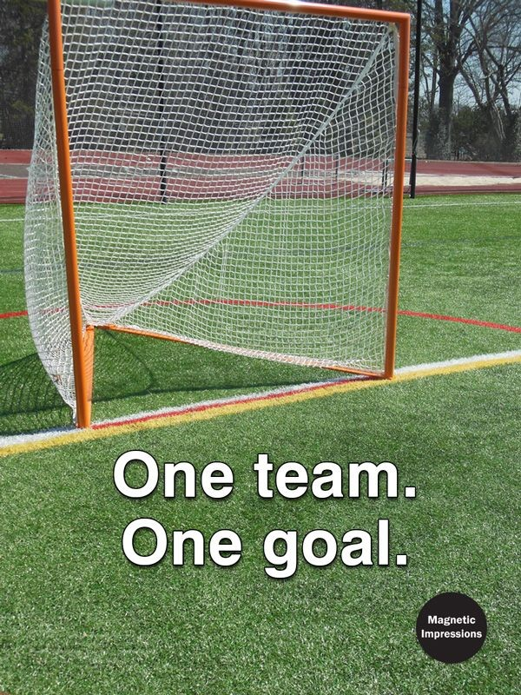
Use Of Collaboration
Figure: 3. Reminding the goal
SOEN 6481 : Software Systems
Requirements

Slide 5

Use Of Collaboration
Figure: 3. Growing as a Team
SOEN 6481 : Software Systems
Requirements

Slide 6
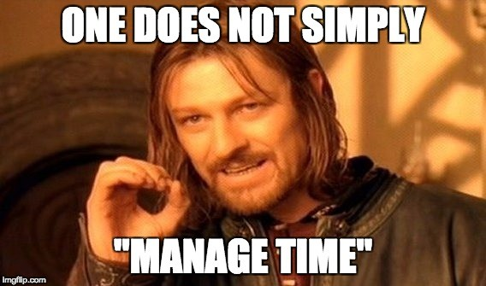
Critical Situation
Figure: 1. Time Management
At the beginning there was no time management schedule. So, we decided one day for the work small time slot for everyday to discuss.
SOEN 6481 : Software Systems
Requirements

Slide 7

Critical Situation
Figure: 3. long-term thinking
Everyone is busy, but just being busy is not enough. Long-term project success requires long-term thinking. Thus, contacted senior students for suggestions.
SOEN 6481 : Software Systems
Requirements

Slide 8
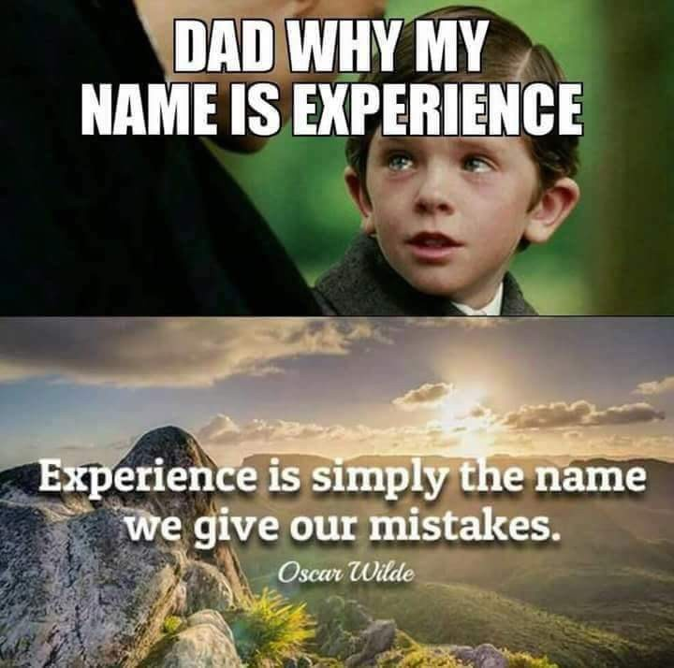
Critical Situation
Figure: 2. Experience
Our team has very small and no experience at all. Thus, contacted senior students and experienced family membe rs.
SOEN 6481 : Software Systems
Requirements

Slide 9

Reuse Potential
Figure: Requirement
We can use requirement in similar projects.
SOEN 6481 : Software Systems
Requirements
9 / 12

Slide 10
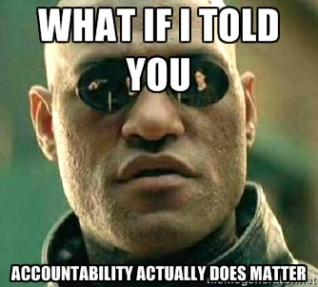
Expect Accountability
Figure: Accountable
A team without accountability measures will be collaborative in a way that isn’t as helpful to team performance as it could be. We Ensure that the goals are set, that team roles are defined. . . and THEN encourage the team to collaborate..
SOEN 6481 : Software Systems
Requirements
November 29, 2019
10 / 12

Slide 11
Lessons Learnt
Have a clear goal
Don’t give up on any member
Be flexible
support them.
Complete task before the time, so everyone can verify each other work.
Solve all concepts related to the project.
SOEN 6481 : Software Systems
Requirements
November 29, 2019
11 / 12

Slide 12

References:
Figure: References
https://9gag.com/meme
https://knowyourmeme.com/memes/memes
SOEN 6481 : Software Systems
Requirements
November 29, 2019
11 / 12

